Slide 1
Divide-and-conquer
Divide-and-conquer method for algorithm design:
Divide: If the input size is too large to deal with in a straightforward manner, divide the problem into two or more disjoint sub problems
Conquer: recursively to solve the sub problems
Combine: Take the solutions to the sub problems and “merge” these solutions into a solution for the original problem

Slide 2
Fibonacci Numbers
Fn= Fn-1+ Fn-2 n ≥ 2
F0 =0, F1 =1
0, 1, 1, 2, 3, 5, 8, 13, 21, 34, 55, …
Straightforward recursive procedure is slow!
Let’s draw the recursion tree

Slide 3
Fibonacci Numbers

Slide 4
Fibonacci Numbers
How many summations are there?
Our recursion tree has only 0s and 1s as leaves, thus we have 1.6^{n} summations
Running time is exponential!

Slide 5
Matrix-chain multiplication
Denote <A₁, A₂, …,A_{n}> by < p₀,p₁,p₂,…,p_{n}>
i.e, A₁(p₀,p₁), A₂(p₁,p₂), …, A_{i}(p_{i-1},p_{i}),… A_{n}(p_{n-1},p_{n})
Different parenthesizations will have different number of multiplications for product of multiple matrices
Example: A(10,100), B(100,5), C(5,50)
If ((A ×B) ×C), 10 ×100 ×5 +10 ×5 ×50 =7500
If (A ×(B ×C)), 10 ×100 ×50+100 ×5 ×50=75000
The first way is ten times faster than the second !!!

Slide 6
Recursion tree for the computation of M(1,4)
1..4
1..1
2..4
1..2
3..4
1..3
4..4

Slide 7
Recursion tree for the computation of M(1,4)
1..4
1..1
2..4
1..2
3..4
1..3
4..4
2..2
3..4
2..3
4..4
1..1
2..2
3..3
4..4
1..1
2..3
1..2
3..3

Slide 8
Recursion tree for the computation of M(1,4)
1..4
1..1
2..4
1..2
3..4
1..3
4..4
2..2
3..4
2..3
4..4
1..1
2..2
3..3
4..4
1..1
2..3
1..2
3..3
3..3
4..4
2..2
3..3
2..2
3..3
1..1
2..2

Slide 9
Divide- and -conquer
Function M(i, j )
if i=j then return 0
Min ←∞
for k ←i to j-1
do mul ← M(i, k)+M(k+1,j)+p_{i-1}p_{k}p_{j}
if mul < Min then Min=mul
End for
return Min

Slide 10
Analysis
The recurrence relation is
We want to show that running time is at least exponential , so that T(n)=

Slide 11
Methods of Solutions of RR
Iteration Method
Substitution Method
Master Methods
Generating functions
Characteristic roots
Undetermined Coefficients

Slide 12
Substitution Method
Guess the form of the solution
Use Mathematical Induction to find the constants and show that the solution works.

Slide 13
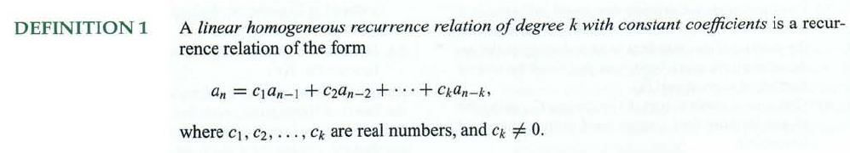

Slide 14
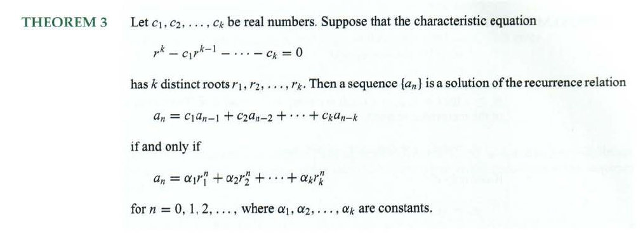

Slide 15


Def : A Linear Non homogeneous Recurrence Relation of degree k with constant Coefficients is a recurrence relation of the form

Slide 16
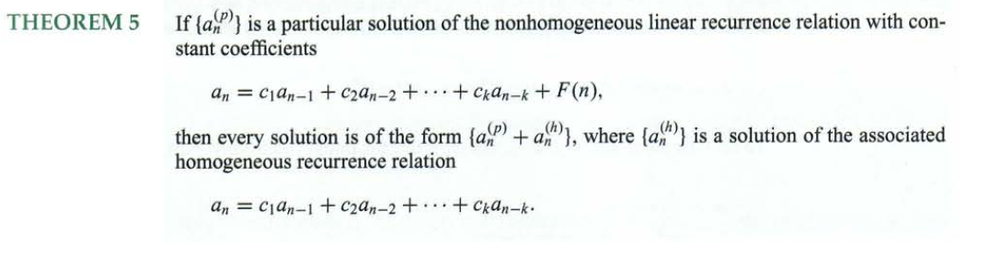

Slide 17
Dynamic programming
Dynamic programming is a way of improving on inefficient divide-and-conquer algorithms.
“Programming” refers to a planning and does not refer to computer programming.
By “inefficient”, we mean that the same recursive call is made over and over.
If same subproblem is solved several times, we can use table to store result of a sub problem the first time it is computed and thus never have to recomputed it again.
Dynamic programming is applicable when the sub problems are dependent, that is, when sub problems share sub problems.

Slide 18
Fibonacci Numbers
We can calculate F(n) in linear time by remembering solutions to the solved sub problems – dynamic programming
Compute solution in a bottom-up fashion
In this case, only two values need to be remembered at any time

Slide 19
Fibonacci Numbers (Top-Down)
// Note: saveF should be a global array initialized all zeros
int Fibonacci(int i)
{
// Simple cases first
if (saveF[i] > 0)
return saveF[i];
if (i <= 1)
return i;
// Recursion
saveF[i] = Fibonacci(i – 1) + Fibonacci(i – 2);
return saveF[i];
}

Slide 20
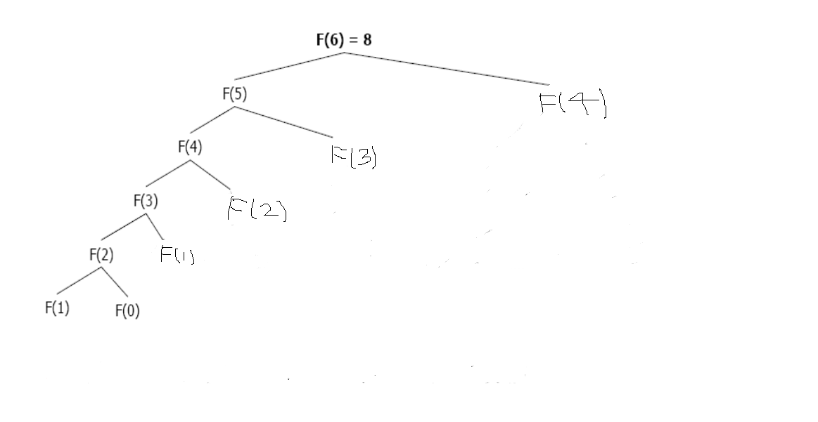
Much less recursion now …

Slide 21
Difference between DP and Divide-and-Conquer
Using Divide-and-Conquer to solve these problems is inefficient because the same common subproblems have to be solved many times.
DP will solve each of them once and their answers are stored in a table for future use.

Slide 22
MCM DP using Bottom-Up
array m[1..n,1..n], with m[i,j] records the optimal cost for A_{i}×A_{i+1}×…×A_{j .}
Suppose the input to the algorithm is p=< p₀ , p₁ ,…, p_{n} >.

Slide 23
MCM DP—order of matrix computations
m(1,1) m(1,2) m(1,3) m(1,4) m(1,5) m(1,6)
m(2,2) m(2,3) m(2,4) m(2,5) m(2,6)
m(3,3) m(3,4) m(3,5) m(3,6)
m(4,4) m(4,5) m(4,6)
m(5,5) m(5,6)
m(6,6)

Slide 24
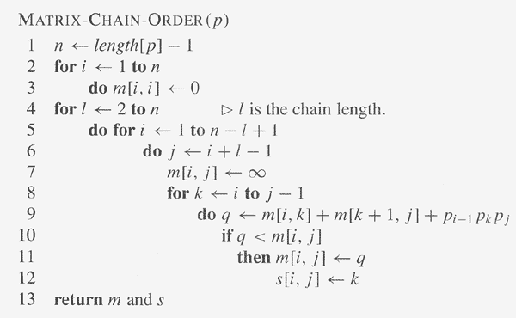
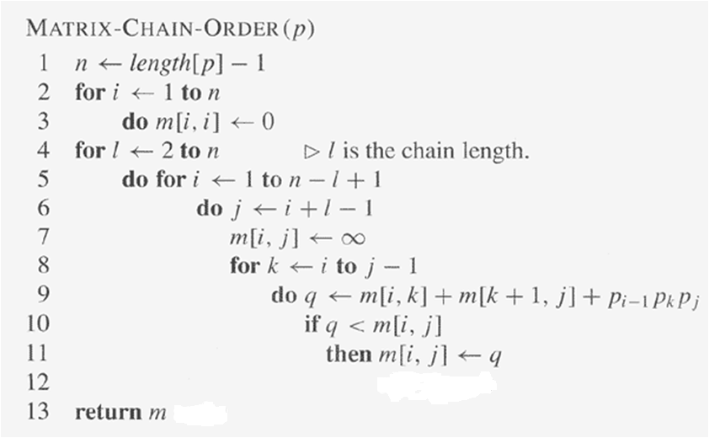
MCM DP using Bottom-Up

Slide 25
Memoization
Memoization is a top-down recursive method that stores intermediate results.
Idea:
When a sub problem is first encountered, its solution needs to be solved and then is stored in the corresponding entry of the table.
If the sub problem is encountered again in the future, just look up the table to take the value.

Slide 26
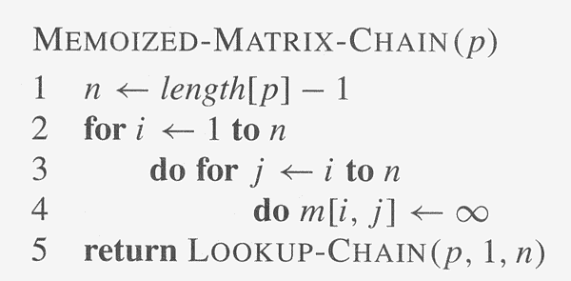
Memoized Matrix Chain
LOOKUP-CHAIN(p, i, j)
if m[i, j]<∞ then return m[i, j]
if i=j then m[i, j] ←0
else for k←i to j-1
do q← LOOKUP-CHAIN(p, i, k)+
LOOKUP-CHAIN(p, k+1 ,j)+p_{i-1}p_{k}p_{j}
5. if q< m[i, j] then m[i, j] ←q
6 . return m[i,j]

